Slide 1
Named Entity Recognition (NER)
Manu Raj L S
GIT Hub Link

Slide 2
Objective
Leverage Neural Network for the task of Named Entity Recognition (NER) to identify the named entities in a certain piece of text
Named Entity Recognition (NER) models can be used to identify the mentions of people, location, organization, times, company names, and so on. So the Named Entity Recognition model not only acts as a standard tool for information extraction but it also serves as a foundational and important preprocessing toll for many downstream applications like Machine Translation, Question-Answering, Customer Feedback Handling, and even Text Summarization.

Slide 3
Approach to solving the problem
Neural networks are well-suited for this type of analysis because they can learn complex patterns in data. However, neural networks require a large amount of training data to learn these patterns.
Recurrent Neural Networks (RNNs) have shown great success in tasks involving machine translation, text analysis, speech recognition, time series analysis, and other sequence-based problems.

Slide 4
Approach to solving the problem..
But RNN have a dreadful problem of “vanishing gradients”. In simple words, the ability of this network to retain or “remember” useful information degrades rapidly, as the length of sequence increases.
An LSTM network is a just a special type of RNN, which tries to mitigate this “remembering” problem.

Slide 5
Model summary
Data Preparation for Neural Networks :
Modifications in the data to prepare it in such a manner so that it can easily fit into a neutral network.
Create a function for splitting the data because the LSTM layers accept sequences of the same length only.
Every sentence that appears as integer in the data must be padded with the same length

Slide 6
Model summary..
Training Neural Network for Named Entity Recognition (NER):
Dimensions from the LSTM layer and will give the maximum length and maximum tags as an output
Create a helper function which will help us in giving the summary of every layer of the neural network model for Named Entity Recognition (NER)
Create a helper function to train the Named Entity Recognition mode

Slide 7
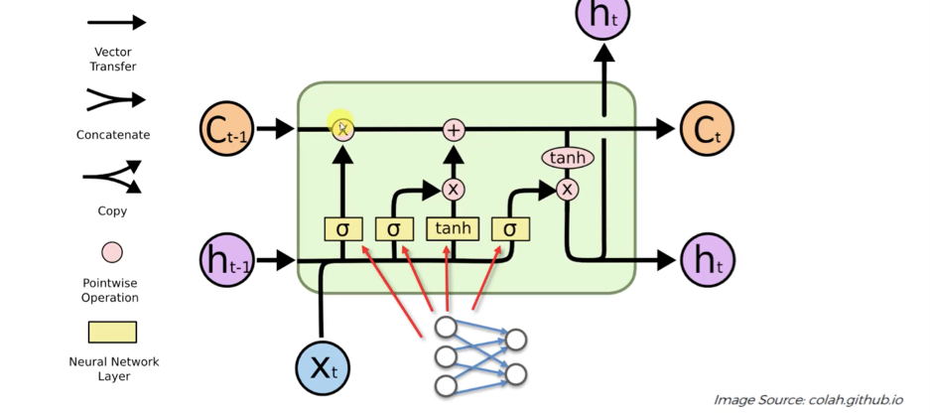
LSTM

Slide 8
Results
Driver code:
Model will give the final output after running for 25 epochs.

Slide 9
Inference
Testing the Named Entity Recognition (NER) Model:
Input text :
'Hi, My name is Manu Raj \n I am from India \n I work with IBM \n Steve Jobs is My Inspiration’
Output :
Hi, My name is Manu Raj I am from India GPE I work with IBM ORG Steve Jobs PERSON is My Inspiration
GPE : Geopolitical entities , ORG : Organization, PERSON : Individual

Slide 10
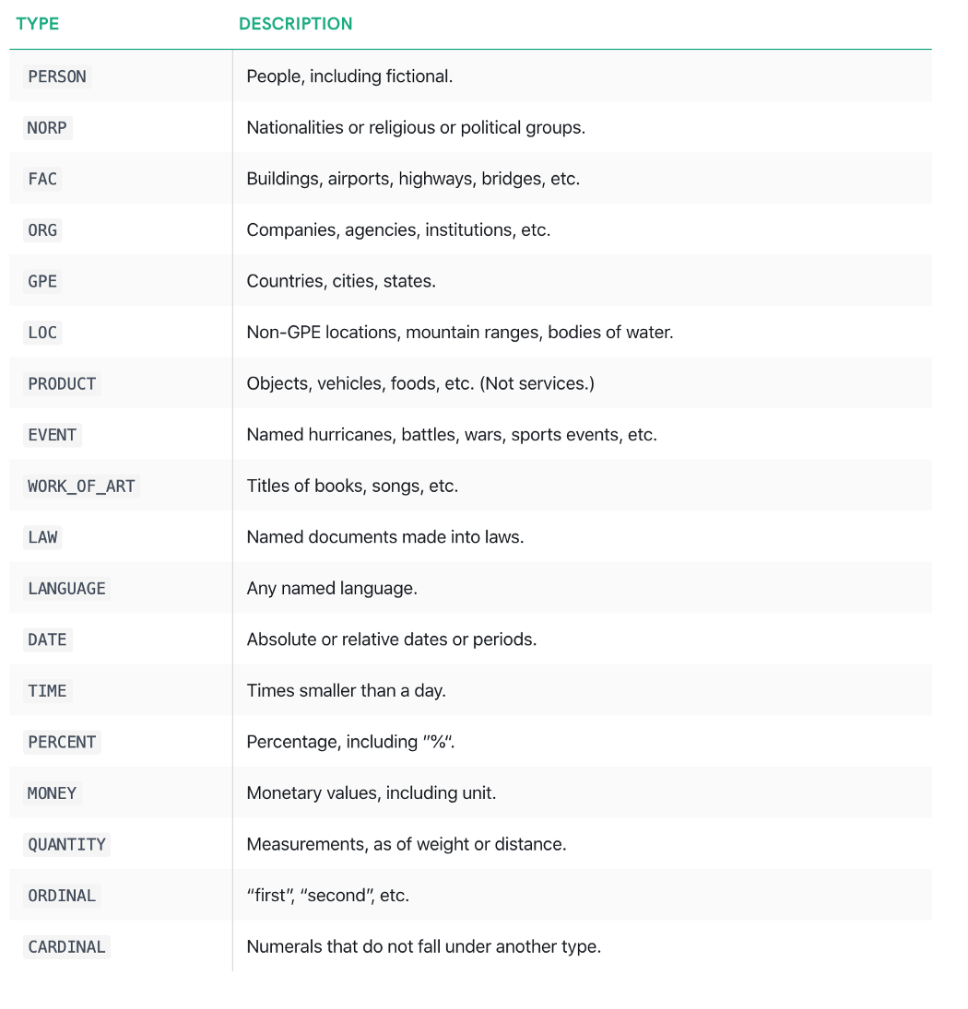
NER Labels

Slide 11
Moving forward
The model is "blind" to the token that appears downstream. One way to resolve this challenge is to introduce a bidirectional LSTM (BiLSTM) network between the inputs (words) and the CRF.
The bidirectional LSTM consists of two LSTM networks - one takes the input in a forward direction, and a second one taking the input in a backward direction.
Combining the outputs of the two networks yields a context that provides information on samples surrounding each individual token.
The output of the BiLSTM is then fed to a linear chain CRF, which can generate predictions using this improved context.
Enhance the training quality through a large amount of labeled training data.

Slide 12
References
https://www.kaggle.com/datasets/abhinavwalia95/entity-annotated-corpus
https://medium.com/towards-data-science/the-fall-of-rnn-lstm-2d1594c74ce0

Slide 13
Thank You
Manu Raj L S

